Slide 1
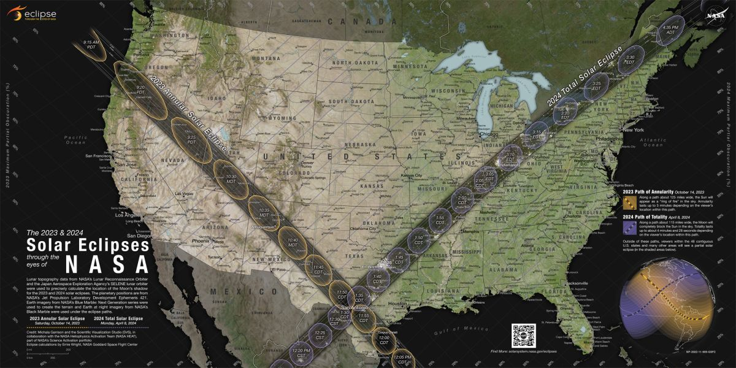
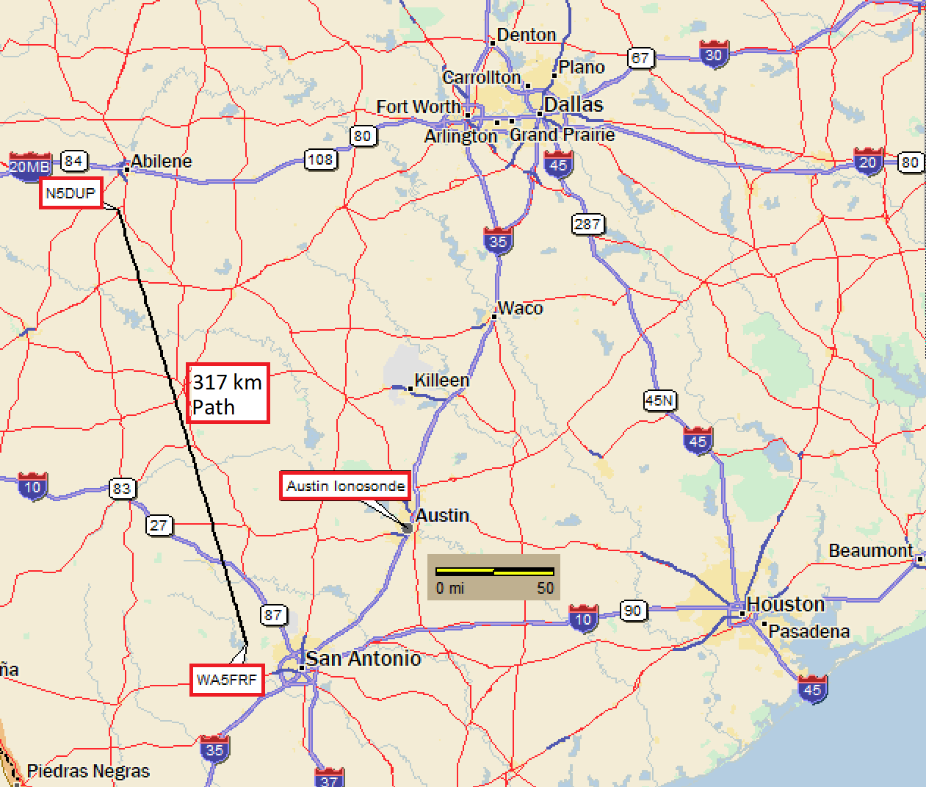
Setup for TDOA Eclipse Experiments
2023 Annular Eclipse
2024 Total Eclipse
N6RFM
N5DUP
407 km
Path
2023
Eclipse
2024
Eclipse
AB5YO
9 km NVIS
Path
WA5FRF
Geometry gave proximity to expected eclipse paths and Austin Ionosonde used for ground truth data.
Notes:
This slide shows the setup for the 2023 and 2024 Eclipse experiments. The radio propagation paths described in this paper are shown in the map overlay on the left. The upper right photo shows the eclipse paths and identifies the map location in Texas. The lower right photo shows amateur radio station WA5FRF used to transmit the TDOA waveforms. Both eclipses passed very nearly overhead this station though angular orientation and path directions were very different.

Slide 2

HamSCI HF Multipath Propagation Mode Analysis Using Amateur Radios and Audio Waveforms Sensitive to Time Difference of Arrival (TDOA)
Steve Cerwin WA5FRF, Jesse T. McMahan K1FR,
Alexandros Papadopoulos KC3WUD, Gerard Piccini KD2ZHK,
Paul Bilberry N5DUP, Sam Blackshear AB5YO
Kristina V. Collins KD8OXT, Nathaniel A. Frissell W2NAV
American Geophysical Union (AGU) Fall Meeting 2024
December 9-13, 2024
steve@cerwinconsulting.com
Notes:
Good morning! My name is Steve Cerwin and I am going to talk about a way of probing the bottom side ionosphere using ordinary amateur radios transmitting and receiving audio waveforms that can reveal the Time Difference of Arrival, or TDOA between multipath propagation modes.

Slide 3
Time Difference of Arrival (TDOA) Experiment to Deduce Multipath Propagation Modes and Measure Ionospheric Layer Heights
This Time Difference of Arrival (TDOA) technique was developed to enable amateur radio operators using ordinary amateur radios to deduce the multipath propagation paths taken between two amateur radio stations and to calculate the F2 layer height between them. Multipath modes observed in this study include simultaneous 1-hop and 2-hop modes from the F2 layer, the E layer, and combinational returns involving both layers.
A geometric model based on virtual height was used to facilitate mathematical analyses. Successful comparisons between calculated F2 layer height, ray tracing simulations, and published hmF2 ionosonde data validated results.
In multipath propagation, the shorter mode arrives first, followed by the longer and they sum in the receiver. The TDOA measurement was implemented by transmitting audio signals sensitive to a time delay when summed.
Evaluated audio waveforms included 1-cycle audio bursts, linear audio chirps, and pseudorandom noise (PN) bursts. Bandwidth of all waveforms was constrained by normal audio communication channels (200-2900 Hz). The chirps performed best and were analyzed by both beat note and correlation methods.
To implement the measurement, the audio signals were fed to the microphone input and recovered from the speaker output of stock SSB amateur radio equipment using .wav file programs.

Slide 4
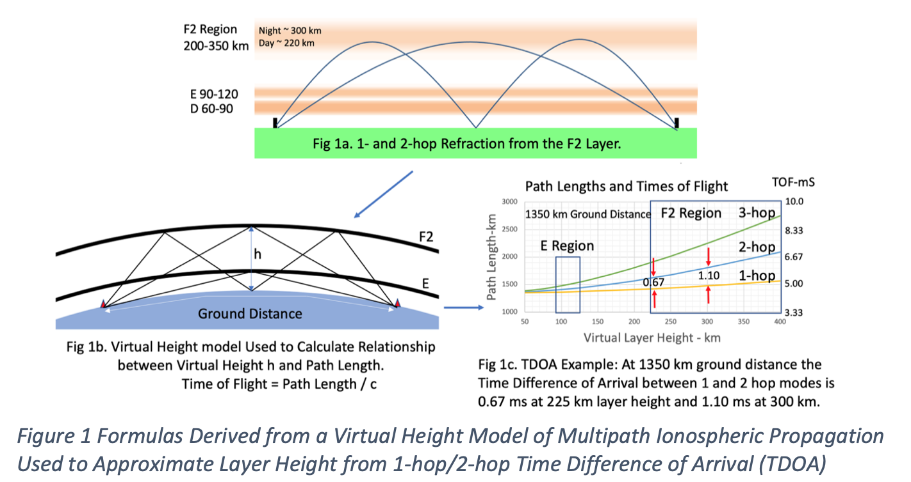
The TDOA Experiment Seeks to Identify Multipath Propagation Modes Between Two HF Radio Stations and Measure F2 Layer Height by Sensing and Analyzing Time Differences of Arrival (TDOA)
Example of ionospheric propagation via refraction
A virtual height model is used to relate layer height and Time of Flight (TOF) for a given ground distance.
The virtual height model simplifies TOF and TDOA calculations for various multipath modes.
Notes:
This illustration shows development of a flexible geometric model to predict how HF radio waves propagate from a transmitter to a receiver over a defined ground distance. The illustration at top center depicts conventional ionospheric propagation via refraction. A simplification enabling easy calculations is the virtual height model shown on the lower left. The curved refractive paths are replaced with straight line extensions that are assumed to undergo specular reflection at a virtual height that gives results very comparable to refractive ray trace modeling. Virtual height modeling has been used for many years. The data acquired with previous WWV Time of Flight studies as well as the present TDOA experiments have shown good agreement with ionosonde hmF2 data. At the lower right is a family of curves calculated by the model showing path lengths and times of flight for 1, 2, and 3 hop modes versus virtual layer height. While an absolute Time of Flight measurement could be used calculate layer height, this illustration shows that the difference in arrival time between two modes can give the same data and is much easier to do. The highlighted example shows the TDOA between 1 and 2 hops from the F2 layer is 0.67 ms at 225 km layer height and 1.10 ms at 300 km. A practical advantage of the TDOA method over Time-of-Flight is simplicity and the ability to use ordinary amateur radios without the requirement for complicated absolute time references at both stations.

Slide 5

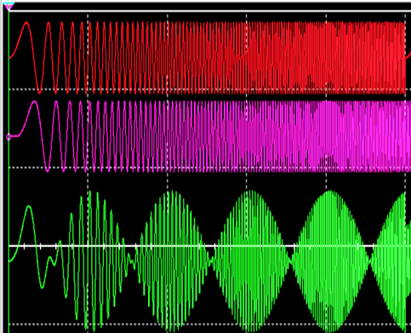
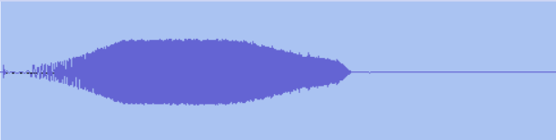
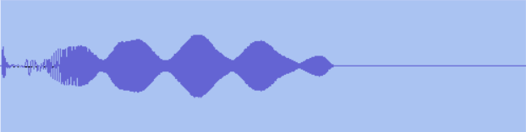
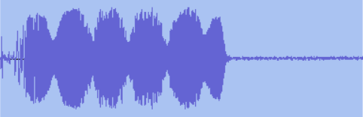
An Audio Frequency Chirp Transmitted By Stock SSB or AM Amateur Radios Can be Used to Measure Time Difference of Arrival (TDOA)
The summation of a linear chirp with a delayed copy of itself produces a beat note frequency at f_{b} = Sweep Rate * Δt.
Beat pattern has a period p = 1/ f_{b}. The Time Difference of Arrival (TDOA= Δt) can be calculated by:
TDOA = f_{b} / Sweep Rate -or- TDOA = 1/ p*Sweep Rate
0 Hz
FULL BANDWIDTH SIMULATION
5 kHz
10 Hz/ms Chirps
10 Repetitions
10 Hz/ms Chirp @ 0 delay
ACTUAL TX-RX WAVEFORMS
280 Hz
3 kHz
0 Hz
5 kHz
B. 10 Hz/ms Chirp delayed 1 ms
Direct – TX & RX1 Passbands
0 Hz
5 kHz
p = 0.063 s
TDOA = 1.6 ms
Ht = 260 km
C. SUM (A+B). Beats occur at period 1/ f_{b}. Summation occurs naturally in receiver
during multipath reception.
0 Hz
5 kHz
317 km Path – 2F₂-1F₂ RX1
p = 0.053 s
TDOA = 1.9 ms
Ht = 315 km
For 1 ms Time Delay f_{b} = 10 Hz
0 Hz
5 kHz
407 km Path. 2F₂ - 1F₂ RX2
Broadband SDR
100 ms=1/10Hz
Notes:
In multipath propagation over a fixed path, the shorter mode arrives first followed by the longer. Both naturally sum in the receiver. The Time Difference of Arrival between the two modes can be measured by using an audio waveform that is sensitive to summation with a delayed copy of itself. A linear frequency chirp is one such waveform. The center illustration is a simulation showing two 10 Hz/ms chirps summed with a 1 ms time delay to represent reception of two multipath modes. The chirps sweep from 0 to 5000 Hz in 500 ms. The 1 ms time delay means the delayed chirp will always be 10 Hz behind throughout the entire overlap period. When summed, this difference frequency manifests as a 10 Hz beat note that shows up as amplitude scalloping in the chirp envelope. In practice, TDOA can be calculated from the received waveform either in the frequency domain by measurement of beat note frequency or the time domain by measurement of beat note period. The audio clip gives the 10-chirp sequence that was used during the 2024 total eclipse. The right three illustrations show waveforms as received in on-air tests. The top waveform was recorded over a direct, non-ionospheric path to show how the chirp waveform envelope can be modified by bandwidth restriction and passband shape in actual radio equipment. Only about 3 kHz of the 5 kHz chirp makes it through a typical SSB TX passband, and overall shape shows the TX-RX low and high frequency skirt responses. The lower two waveforms show appearance of waveforms undergoing actual multipath interference. The center waveform shows a 1.6 ms TDOA over a 317 km path, which is consistent with 1 and 2 hops from the F2 layer at a height of 260 km. The bottom waveform similarly shows a TDOA of 1.9 ms over a 407 km path, which is consistent with 1 and 2 hops from the F2 layer at a height of 315 km.

Slide 6
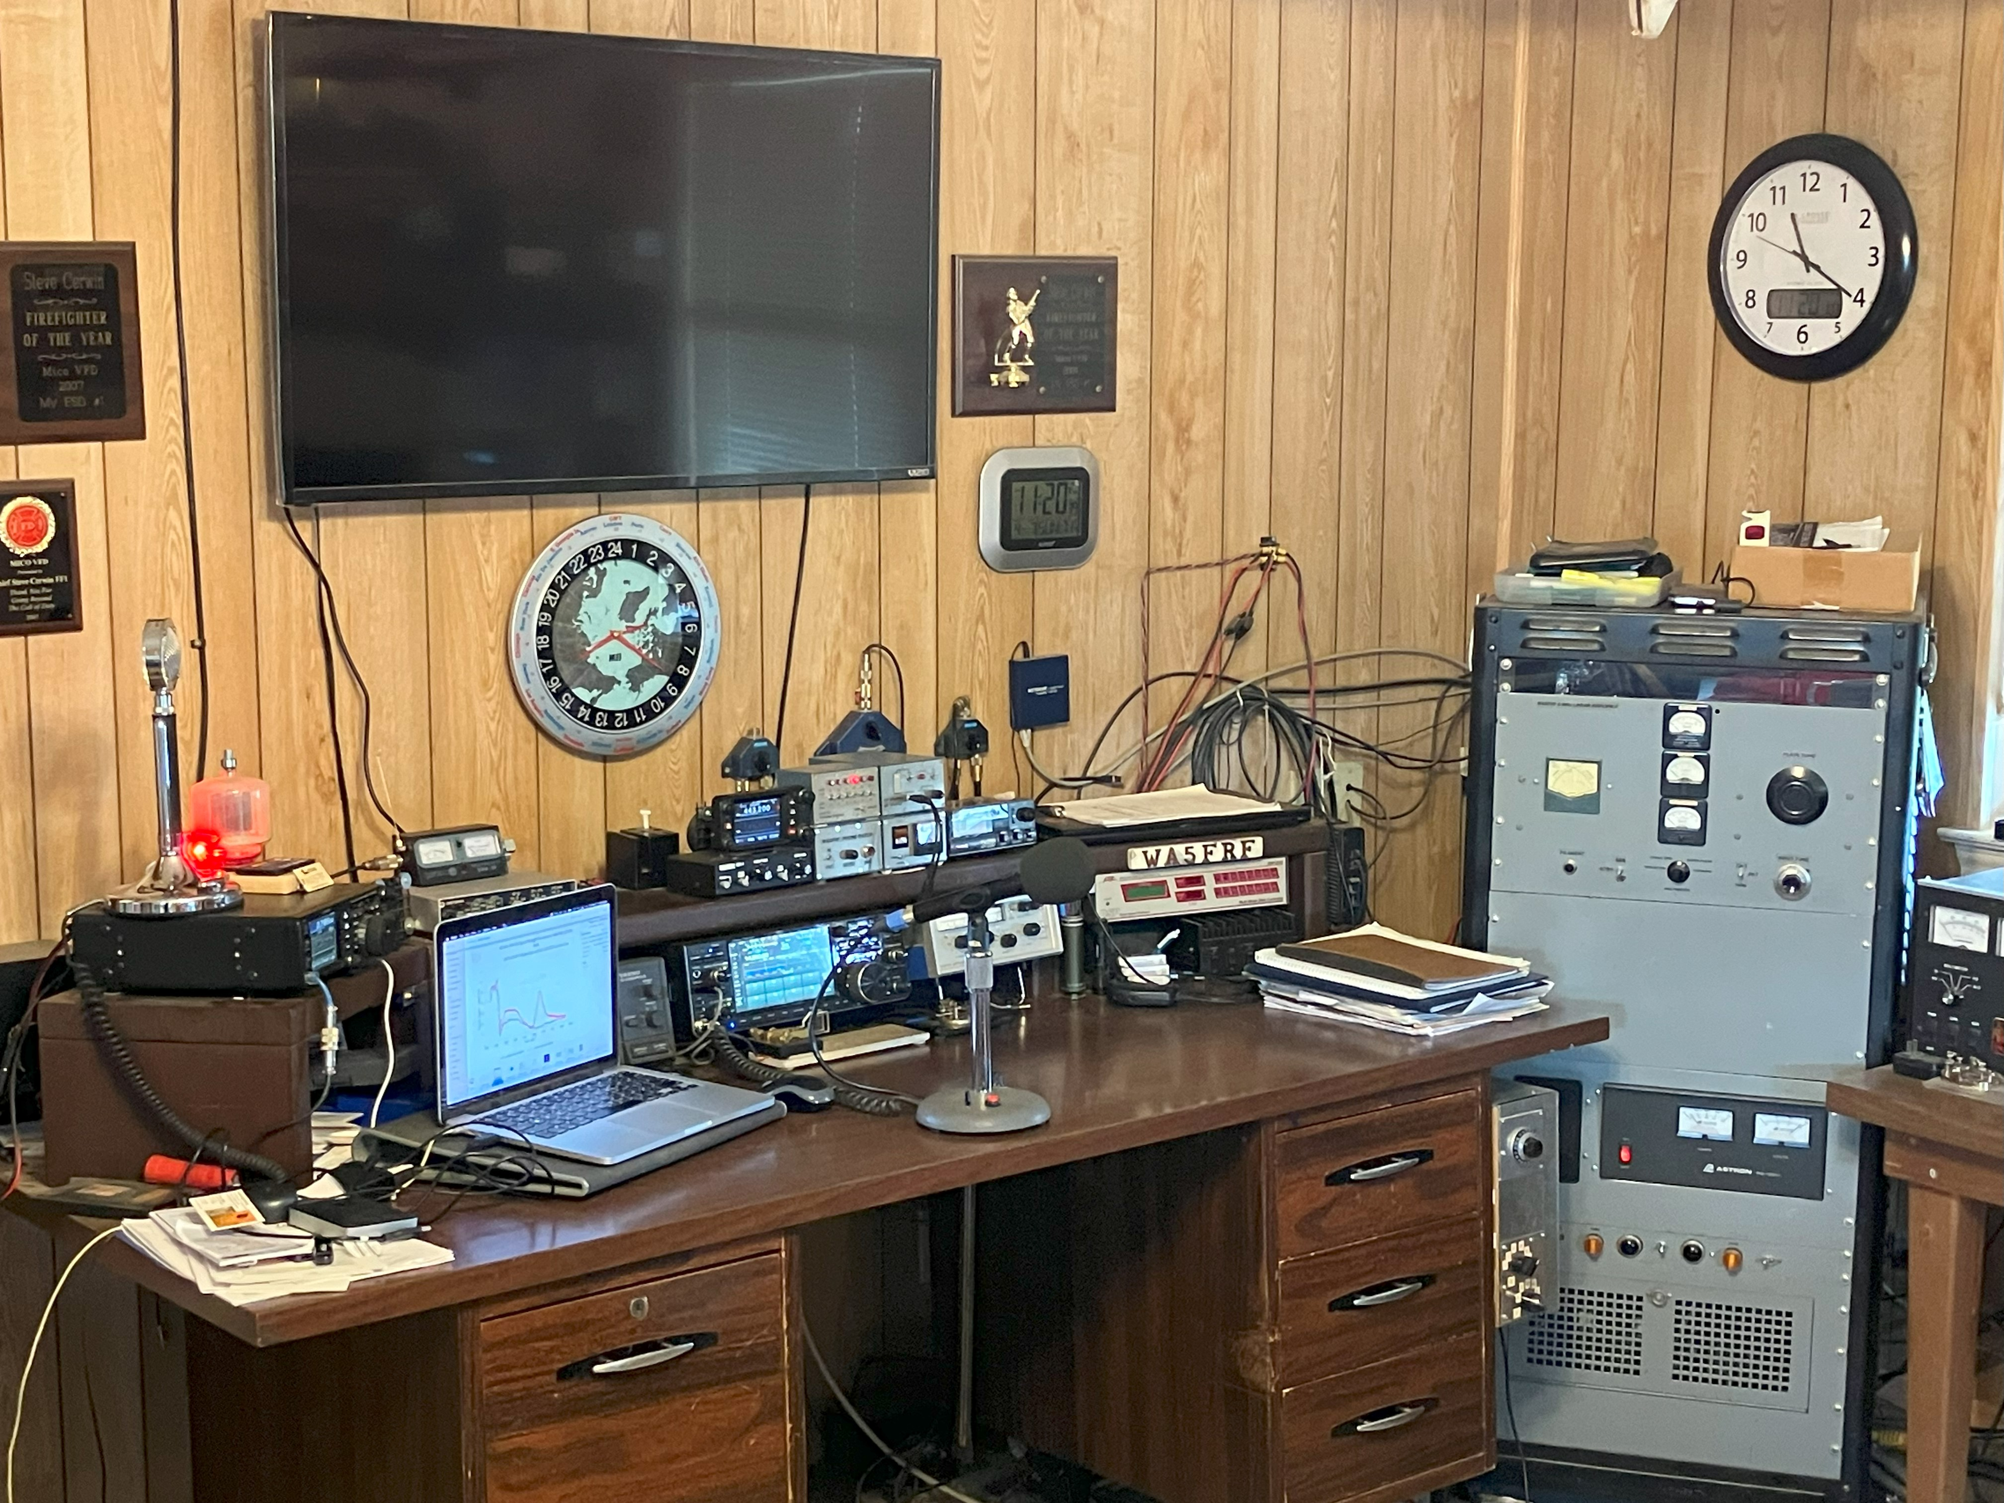
Setup for TDOA Eclipse Experiments
2023 Annular Eclipse
2024 Total Eclipse
407 km
Path
9 km NVIS
Path
Transmitting Amateur Radio Station WA5FRF
Geometry gave proximity to expected eclipse paths and Austin Ionosonde used for ground truth data.
Notes:
This slide shows the setup for the 2023 and 2024 Eclipse experiments. The radio propagation paths described in this paper are shown in the map overlay on the left. The upper right photo shows the eclipse paths and identifies the map location in Texas. The lower right photo shows amateur radio station WA5FRF used to transmit the TDOA waveforms. Both eclipses passed very nearly overhead this station though angular orientation and path directions were very different.

Slide 7
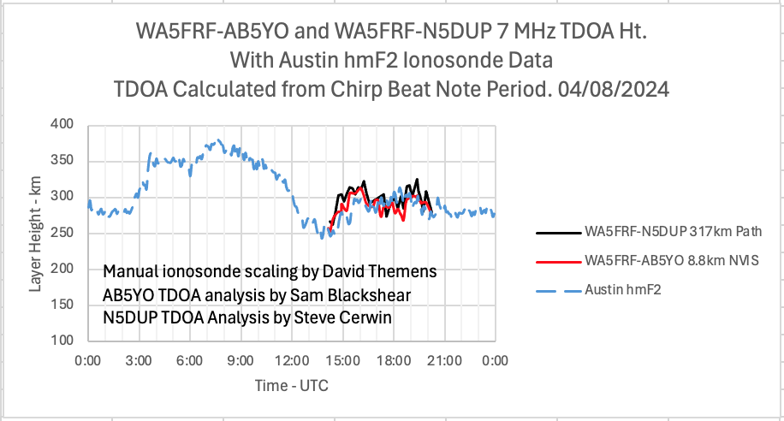
Layer Heights Calculated from TDOA at the Same Frequency Over Different Path Lengths Agreed Well with Each Other and With the Austin, TX Ionosonde
Manual ionosonde scaling averaged height data for higher resolution.
Transmit: WA5FRF near San Antonio, TX. Waveform: 10 Hz/ms Chirps.
Receive: AB5YO at 8.8 km and N5DUP at 317 km near Abilene, TX.
Eclipse Path of Totality was almost directly overhead TX location and nearly aligned with 317 km path.
Notes:
The next several charts show TDOA data collected during the 2023 and 2024 North American eclipses. This chart shows same-frequency data over two very different path lengths: a short NVIS path to a local station only 9 km away and a 317 km path that was in the same direction as the eclipse Path of Totality. Measured TDOA was consistent with 1 and 2 hops from the F2 layer, though the NVIS multipath could have been between ground wave and 1 or more hops from F2. The calculated F2 layer height data from both paths agreed well with each other and with hmF2 data from the Austin, TX ionosonde. Data were acquired from 1400 UTC to 2030 UTC which included local totality at the TX site at 1830 UTC. The measured height profile resembles a two-hump saddle with one peak at 1530 UTC and a second near the time of totality passage at 1830 UTC.

Slide 8
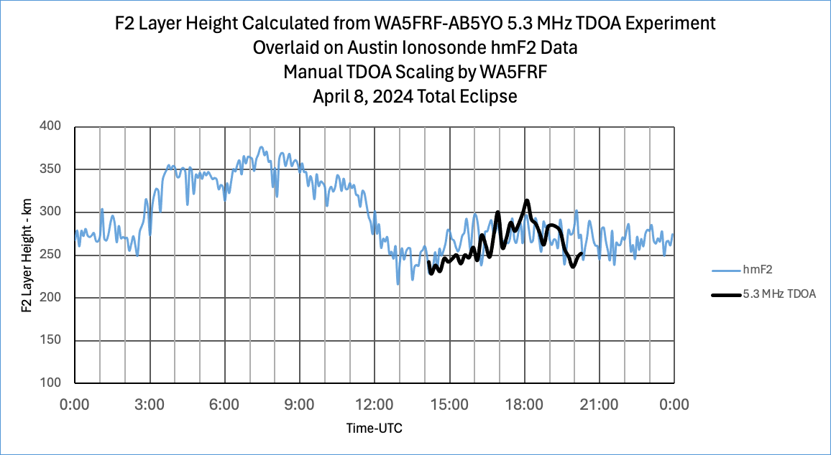
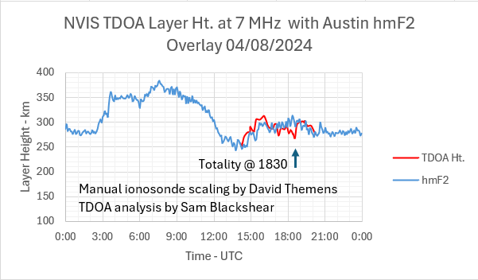
Simultaneous TDOA Measurements at Different Frequencies Over the Same Path Gave Different Height Profiles
Standard ionosonde scaling
Eclipse Passage
5.3 MHz TDOA data showed a height bump near the time of eclipse passage in Texas.
Austin ionosonde hmF2 overlay.
7.3 MHz TDOA data did not show a height bump. Manually scaled ionosonde hmF2 overlay.
Path: 8.8 km ground distance for Near Vertical Incidence Skywave (NVIS)
5.3 MHz data analyzed by Steve Cerwin WA5FRF; 7.3 MHz data analyzed by Sam Blackshear AB5YO
Notes:
These charts show TDOA data taken over the same NVIS path at two different frequencies of 5.3 MHz and 7.3 MHz. Both plots include the hmF2 overlay from the Austin, TX ionosonde. The calculated F2 layer height profile at 5.3 MHz showed definite peaking over the acquisition window with a well-defined peak that occurred about 20 minutes before local totality. Note that incident sun angle also peaks over this period. The 7.3 MHz data set showed the double-hump saddle with the second peak at 30 minutes after totality. The Austin ionosonde showed general peaking over this time window with only a modest peak at the time of totality. These TDOA data sets show a clear frequency dependence while still being generally consistent with Austin hmF2. Definite frequency dependent height bumps were obtained during the 2023 annular eclipse and reported at the 2023 AGU Fall meeting.

Slide 9
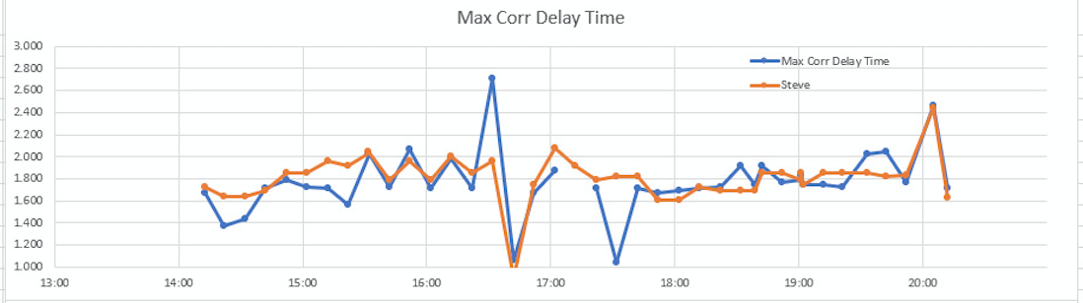
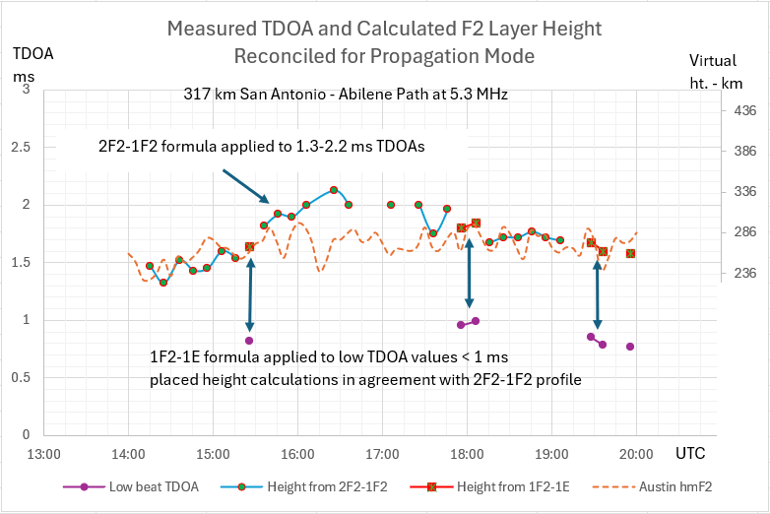
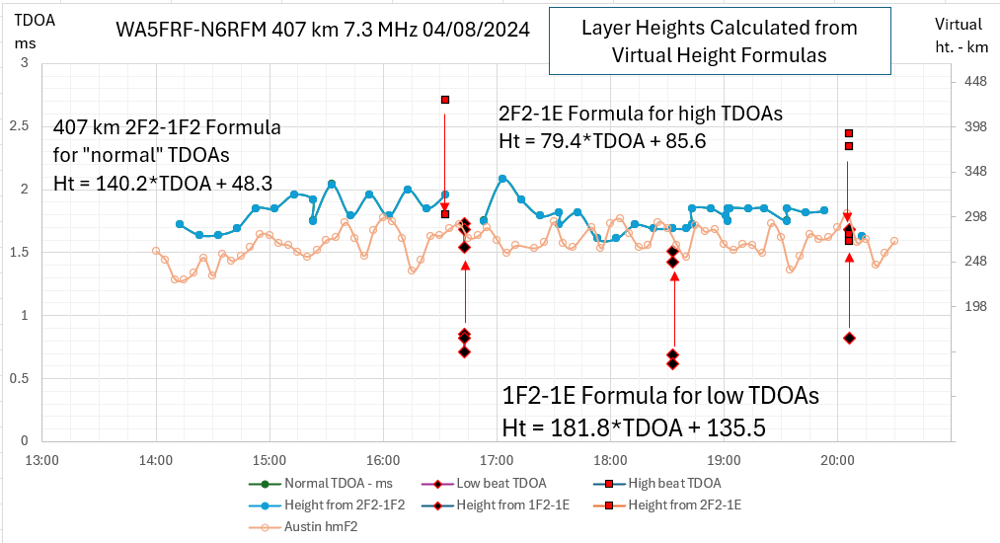
TDOA “Outliers” Gave Consistent Layer Height Calculations when Processed with the Right Multi-Mode Formula
Beat Note and Correlation TDOA Processing
Correlation Processing
Beat Note Processing
Time UTC
TDOA “Outliers” were Found to Have TDOA Values that Matched Mixed Layer Propagation
N.B. Internet SDR Receiver
Keller, TX
Time UTC
N.B. See Poster Paper SA51D-2371 by Alexandros Papadopoulos et al for TDOA data plots showing many more mixed-layer captures identified by using an automated FFT analysis of chirp beat note frequency.
Notes:
Chirp envelopes with unusual beat frequency patterns were observed throughout all the data sets. TDOA values from these chirps produced low and high data outliers on many of the plots as shown in the chart on the upper right. The spreadsheet-based virtual height model made it easy to predict TDOA values for combinational modes involving both the E and F2 layers. The lower left chart for the 317 km path had TDOA outliers that were well below the usual values corresponding to 1 and 2 hops from the F2 layer. But when these TDOA values were used with formulas for 1 hop from F2 and 1 hop from the E layer, the calculated F2 layer heights fell right inline with the rest of the height profile. This mode was predicted over this path by a PHaRLAP ray tracing simulation performed by Nathaniel Frissell W2NAV. The chart for a 407 km path shown on the lower right had both unusually low and high TDOA outliers. Applying the formula for 1 hop from F2 and one from E to the low values and the formula for 2 hops from F2 and 1-hop from E to the high values produced a consistent F2 height profile for all TDOA values. It is suspected that this mode occurred at this time and frequency because the E layer was reflective enough to completely block the comparatively low angle required for 1-hop from F2 while being transparent enough to pass the higher angle required for the 2-hop F2 mode.

Slide 10
Summary Observations and Future Development
The Time Difference of Arrival (TDOA) method has demonstrated the ability to calculate ionization layer height when reconciled with a virtual height model of the ionosphere. Experimental results gave good agreement with ionosonde hmF2 data.
Received chirp waveforms must be vetted for quality and mode identification.
TDOA-derived F2 height calculations showed path invariance when performed at the same frequency over different path lengths but frequency dependence when performed at different frequencies over the same path.
The height bumps observed during the 2023 annular eclipse and reported at AGU last year were not as distinct in the 2024 total eclipse data. A potentially significant difference is the direction of eclipse passage and angular orientation relative to the propagation path. Frequency dependencies were noted in the height bumps in both data sets.
E layer transmission/reflection properties appeared to drive multipath mode by selectively blocking access to the F2 layer. Correlation with WWV Doppler spectrograms should provide additional insight to layer behavior and is planned.
Best conditions for measuring F2 layer height were obtained with ground distances less than 1000 km where the TDOA values are longer and better defined. The higher angles penetrate the E layer better for improved F2 layer access.
A limitation with the current chirp waveform is the short time duration imposed by audio bandwidth restrictions in amateur radios. A series of concatenated up-down chirps is under development to obtain an arbitrarily long beat note waveform while remaining within common audio passbands.

